Slide 1
File Handling in Java, Java Language Features & Syntax
A Comprehensive Guide to Core Concepts and Practical Applications
Presented By: S. Samuel Rickson

Slide 2
Java Language Features - Overview
Platform Independent: "Write Once, Run Anywhere" (WORA) - Java code compiles to bytecode, executed by the Java Virtual Machine (JVM).
Object-Oriented: Based on objects, classes, inheritance, polymorphism, abstraction, and encapsulation.
Simple & Secure: Designed to be easy to learn and robust against common programming errors. Built-in security features.
Robust: Strong memory management (garbage collection), exception handling, and type checking for reliability.
Multithreaded: Supports concurrent execution of multiple parts of a program, leading to efficient resource utilization.
High Performance: Just-In-Time (JIT) compilers convert bytecode to native machine code at runtime.

Slide 3
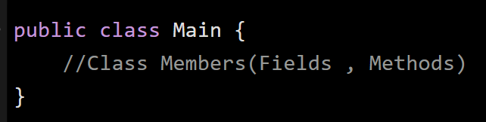
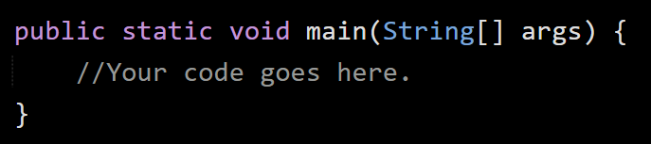
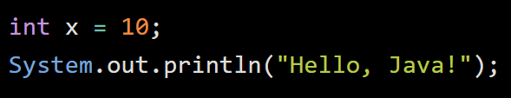
Java Syntax & Basic Structure
Case Sensitive: myVariable is different from MyVaraible.
Class Definition: All Java code resides within classes.
Main Method: The entry point for any Java Application
Statements: End with a semi-colon ;
Comments: // Single-line, /* Multi-line */, /** Javadoc */

Slide 4
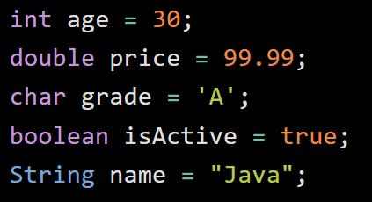
Key Java Language Features - Data Types
Java data types specify the size and type of values that can be stored in variables.
Primitive Data Types:
Integer Types: byte, short, int, long (whole numbers)
Floating-Point Types: float, double (numbers with decimal points)
Character Type: char (single characters)
Boolean Type: boolean (true or false)
Non-Primitive (Reference) Data Types:
Classes: e.g., String, Scanner, File
Interfaces: Define contracts for classes.
Arrays: Collections of elements of the same type.

Slide 5
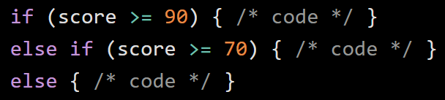
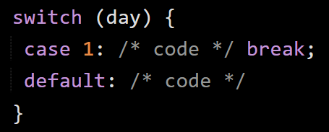
Control Flow Structures
Conditional Statements:
if-else if-else: Executes different blocks based on conditions.
switch: Selects one of many code blocks based on a value.

Slide 6


Looping Statements:
for-loop: Executes a block a specified number of times.
while-loop: Repeats a block as long as a condition is true.
do-while loop: Executes at least once, then repeats if condition is true.
for-each loop:Iterates over arrays and collections.

Slide 7
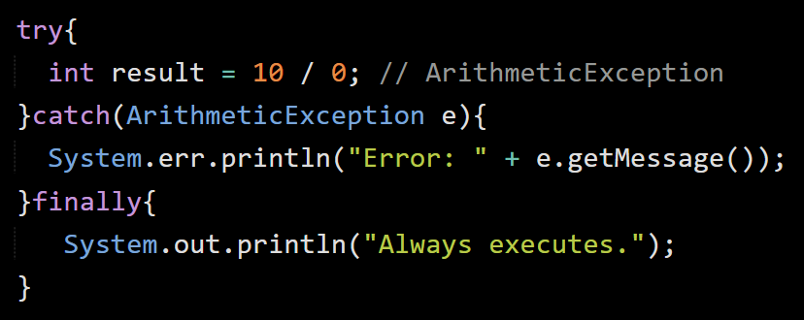
Key Java Language Features - Exception Handling
Keywords:
try: Encloses code that might throw an exception.
catch: Catches and handles a specific type of exception.
finally: Executes code regardless of whether an exception occurred.
throw: Used to explicitly throw an exception.
throws: Declares that a method might throw an exception.
Types of Exceptions
Checked Exceptions:
Must be caught or declared.
Unchecked Exceptions:
Do not need to be explicitly caught.
Errors:
Serious Problems, not typically caught.

Slide 8
File Handling in Java - Introduction
What is File Handling? Performing operations on files (reading, writing).
Why is it important?
Data Persistence: Store data permanently on disk.
Configuration: Read application settings.
Logging: Record application events.
Data Exchange: Interact with other applications
Java I/O Streams: Represent data flow.
Input Stream: Reads data from a source (e.g., file).
Output Stream: Writes data to a destination (e.g., file).
Can be byte-oriented (raw binary data) or character-oriented (text data).

Slide 9
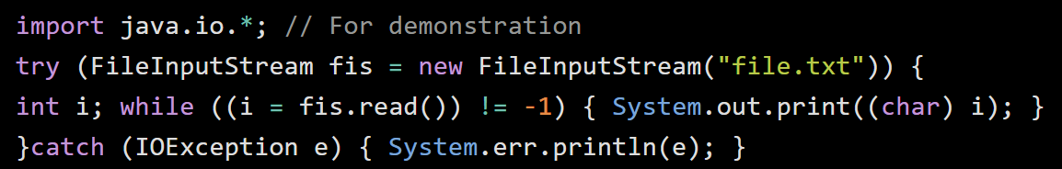
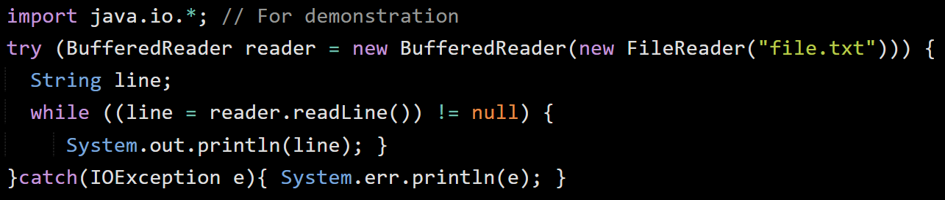
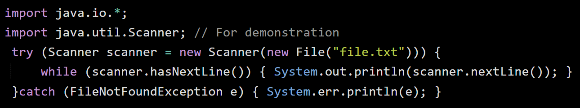
File Handling - Reading Files
Various classes for reading data from files.
FileInputStream(Byte Stream): Reads raw bytes
BufferedReader(Character Stream): Reads text efficiently, line by line.
Scanner: Versatile for parsing primitive types and strings

Slide 10
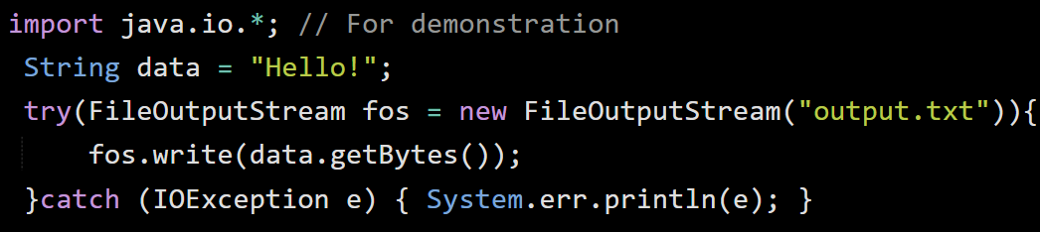
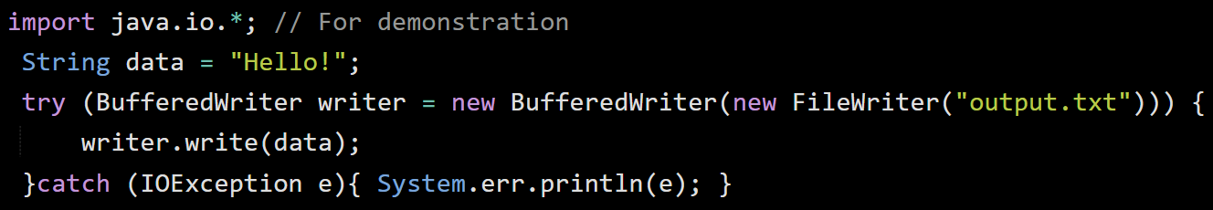
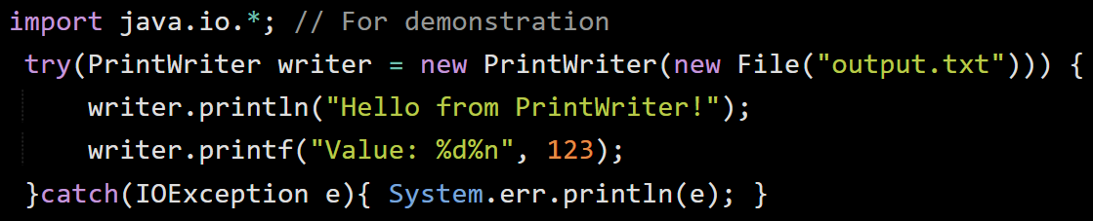
File Handling - Writing Files
Various classes for writing data to files.
FileOutputStream(Byte Stream): Writes raw bytes.
BufferedWriter(Character Stream): Writes text efficiently.
PrintWriter: Writes formatted data to text files.

Slide 11
Conclusion & Best Practices
Summary:
Java is a powerful, object-oriented, and platform-independent language.
Core features (data types, control flow) are fundamental.
Exception handling is crucial for robust applications.
File handling allows data persistence.
Best Practices for File Handling:
Always use try-with-resources: Ensures streams are properly closed.
Handle IOException: Essential for robust error handling.
Choose the Right Stream: Byte for binary, character for text; use buffered streams for performance.
Specify File Paths Carefully: Use correct absolute or relative paths.
Consider java.nio.file(NIO.2): For modern file system operations.

